Slide 1


Instagram User Analytics
SQL Fundamentals

Slide 2

Instagram User Analytics
In this project, I am utilizing SQL and MySQL Workbench to analyze Instagram user data and address questions from the management team. These insights will assist the product manager and the rest of the team in making informed decisions about the future direction of the Instagram app.
Using SQL and MySQL Workbench

Slide 3
Marketing Analysis:
1.Loyal User Reward : The marketing team wants to reward the most loyal users, i.e., those who have been using the platform for the longest time.
Your Task : Identify the five oldest users on Instagram from the provided database.

Slide 4
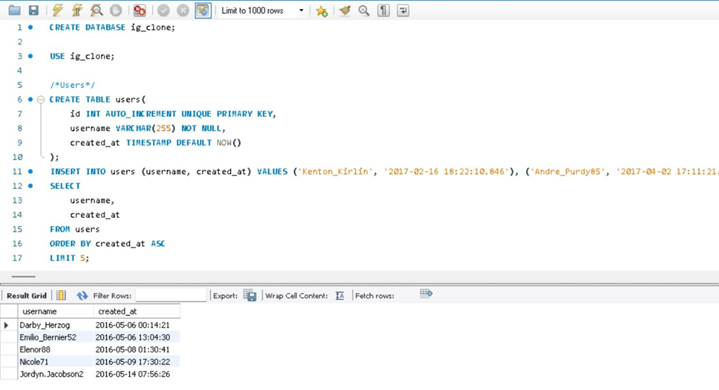
The five oldest users on Instagram

Slide 5
Marketing Analysis:
2.Inactive User Engagement : The team wants to encourage inactive users to start posting by sending them promotional emails.
Your Task : Identify users who have never posted a single photo on Instagram.

Slide 6
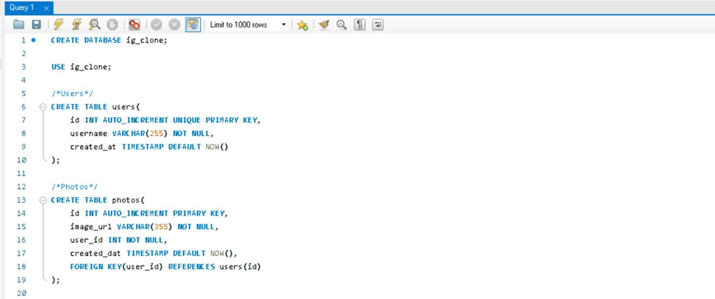
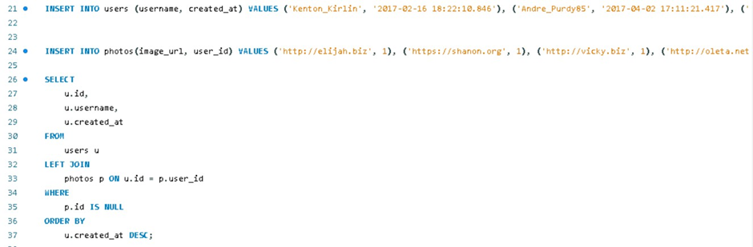
Users who have never posted a single photo on Instagram - Query

Slide 7
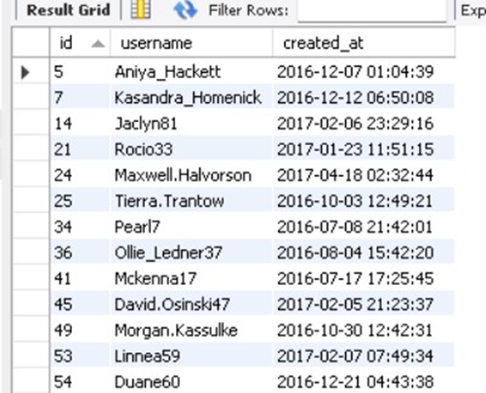
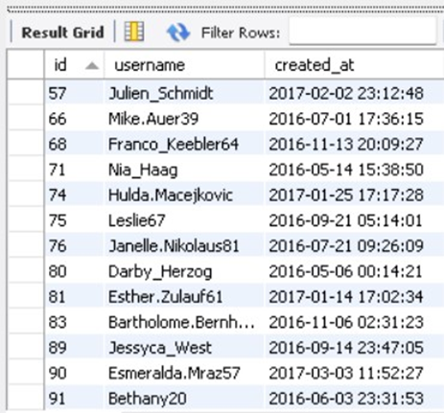
Users who have never posted a single photo on Instagram - Result

Slide 8
Marketing Analysis:
3.Contest Winner Declaration : The team has organized a contest where the user with the most likes on a single photo wins.
Your Task : Determine the winner of the contest and provide their details to the team.

Slide 9
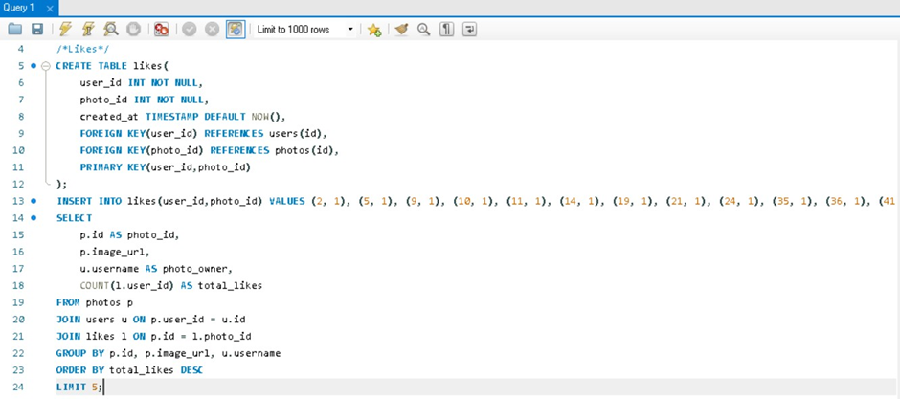
The winner of the contest and their details - Query

Slide 10
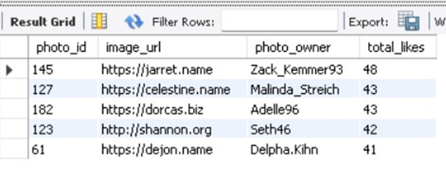
The winner of the contest and their details - Result

Slide 11
Marketing Analysis:
4.Hashtag Research : A partner brand wants to know the most popular hashtags to use in their posts to reach the most people.
Your Task : Identify and suggest the top five most commonly used hashtags on the platform.

Slide 12
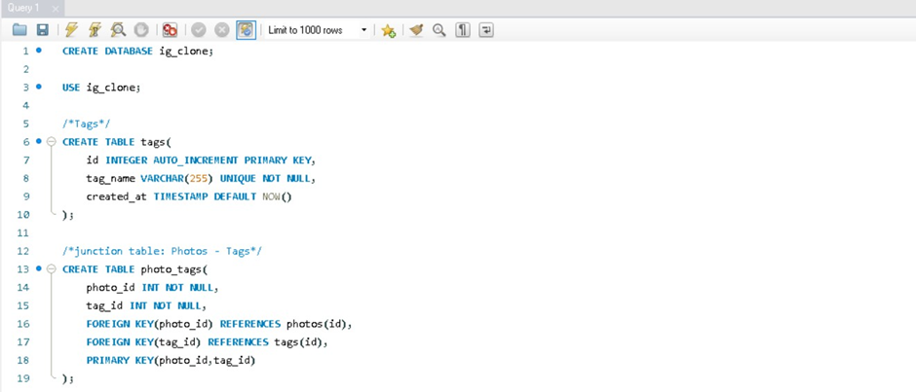
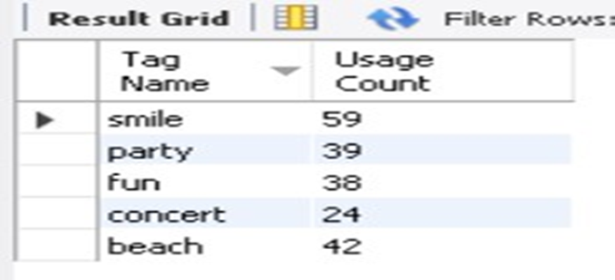
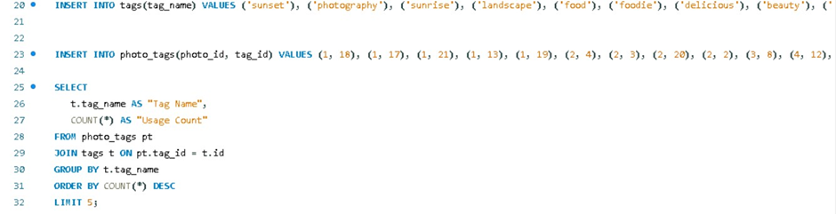
The top five most commonly used hashtags

Slide 13
Marketing Analysis:
5.Ad Campaign Launch : The team wants to know the best day of the week to launch ads.
Your Task : Determine the day of the week when most users register on Instagram. Provide insights on when to schedule an ad campaign.

Slide 14
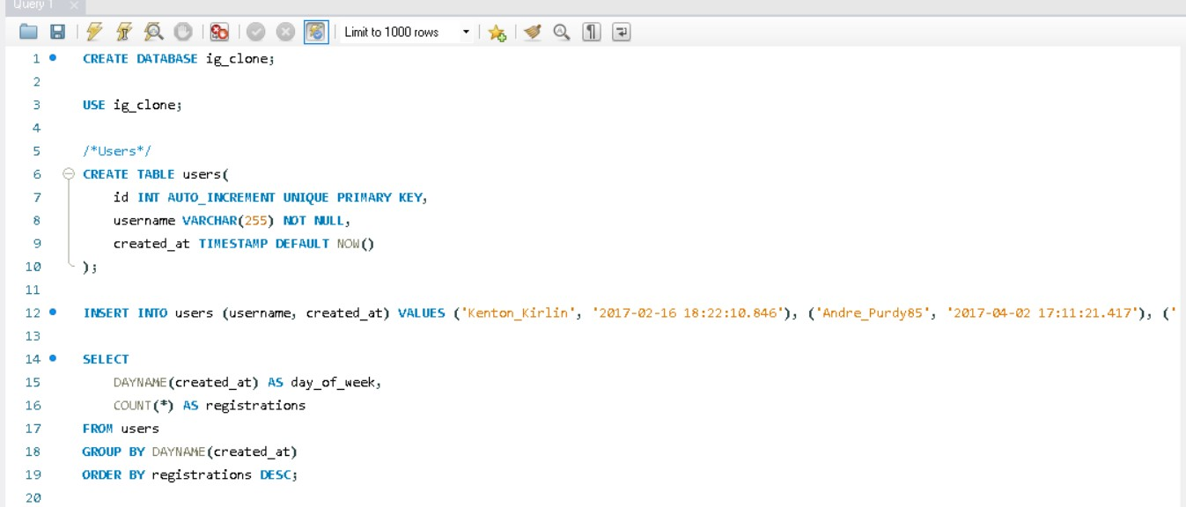
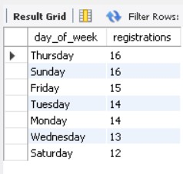
The days of the week when most users register on Instagram

Slide 15
Investor Metrics:
1.User Engagement : Investors want to know if users are still active and posting on Instagram or if they are making fewer posts.
Your Task : Calculate the average number of posts per user on Instagram. Also, provide the total number of photos on Instagram divided by the total number of users.

Slide 16
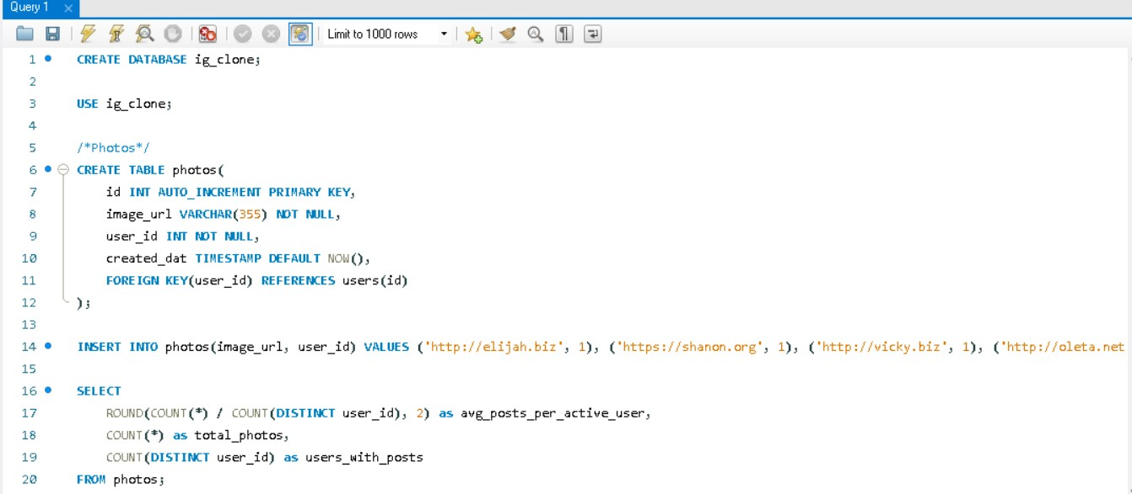
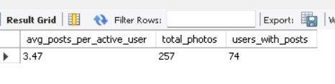
The average number of posts per user on Instagram

Slide 17
Investor Metrics:
2.Bots & Fake Accounts : Investors want to know if the platform is crowded with fake and dummy accounts.
Your Task : Identify users (potential bots) who have liked every single photo on the site, as this is not typically possible for a normal user.

Slide 18
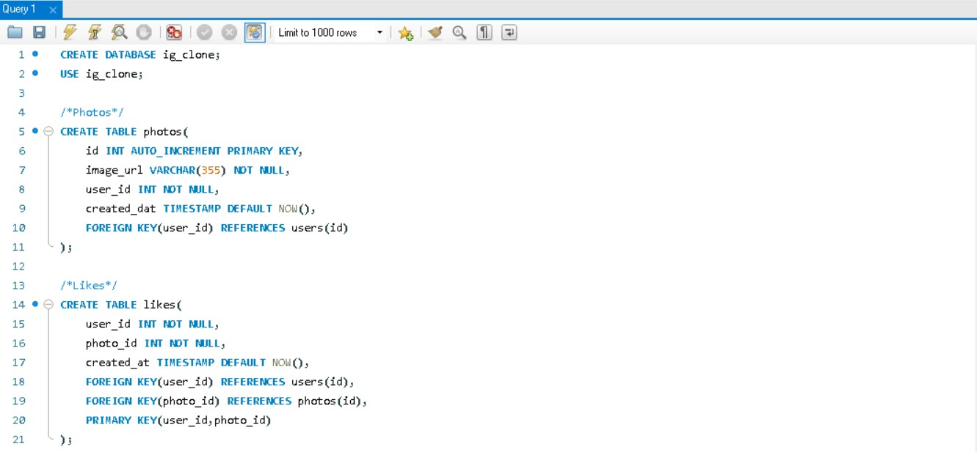
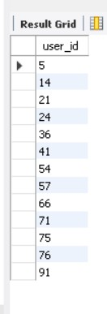
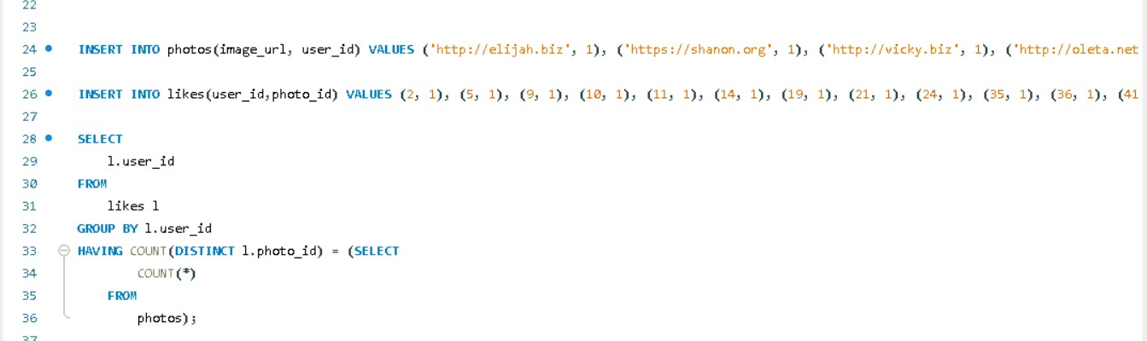
Users (potential bots) who have liked every single photo on the site

Slide 19

THANK YOU!

